Slide 1

Question Answering Systems
By
Premkumar Bhaskaran
Srikanth Kadaba Bhogananda
Sakthi Kripa Selvan

Slide 2

Agenda:
Question Answering Systems - An Introduction
Stanford Question Answering Dataset (SQuAD)
Approach
Model Architectures
Training and Metrics
Results

Slide 3

Question Answering Systems - An Introduction
Extracting relevant information from the documents to put forth detailed answer
Closed and Open Domain Question Answering systems
Open datasets available for QA systems: Stanford Question Answering Dataset (SQuAD), WikiQA, Trec-QA, NewsQA datasets
Most documents are stored in digital formats
Example applications
Enterprise FAQ bot
Law and Medical firms

Slide 4
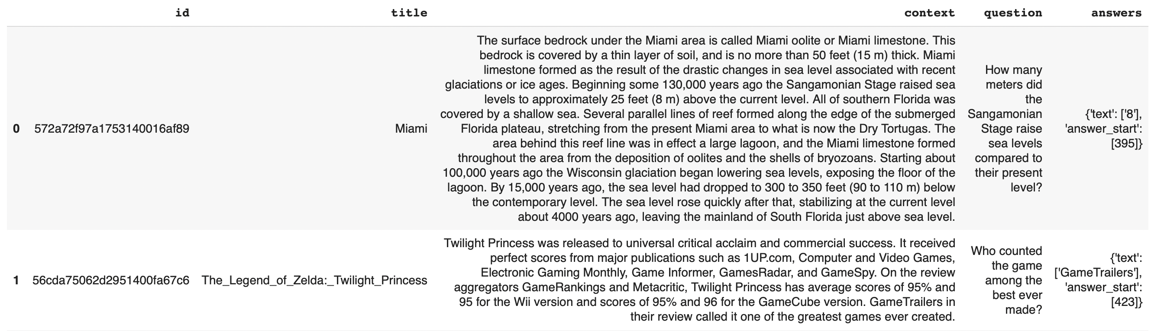
Stanford Question Answering Dataset (SQuAD)
Collection of questions by crowd-workers on Wiki articles.
Annotated answer labels by expert Wiki contributors.
Systems must select the answer from all possible spans in the passage
100,000+ question-answer pairs on 536 articles
Why
Most used and completed QA dataset
Starting point for building systems in industry
Limitations:
Only span based answers like yes/no, implicit why, counting
Questions were constructed looking at passages

Slide 5
Approach
Traditional Approach
Recurrent Neural Networks
Disadvantages:
Training time
Large dataset
Modelling long term dependency
Transformer architecture
Eliminates recurrence
Models long term dependency

Slide 6
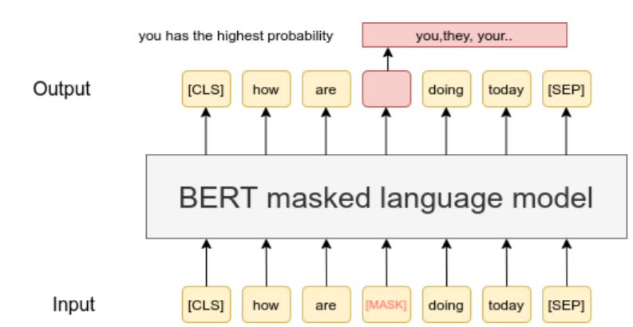
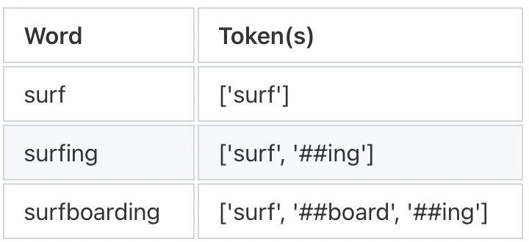
BERT
Training Phase
Pre-training
Masked Language Model
Next Sentence Prediction
Fine-tuning
Word Piece tokenization
Final inputs
Special tokens: [CLS], [SEP]
Segment Embedding
Position Embedding
Pre-trained BERT model from Huggingface fine-tuned for QA system
Source:Paper

Slide 7
DistilBERT
BERT disadvantages
Large number of parameters
Computational resources
Small, fast, cheap and light Transformer model trained by distilling BERT base
Compress and transfer the knowledge from a computationally expensive large deep neural network(Teacher) to a single smaller neural work(Student) - Knowledge Distillation

Slide 8
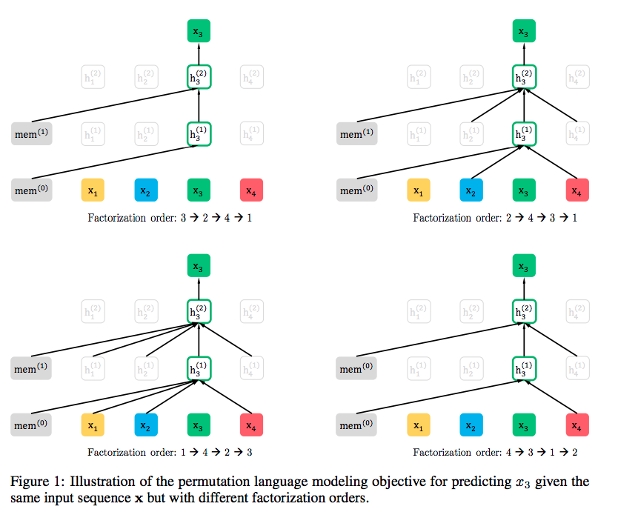
XLNet
Generalized autoregressive pretrained model
XLNET – Autoregressive, BERT – Autoencoders
Permutation language modelling
Empirically proven to outperform BERT
Source: Paper

Slide 9
Training:
Converting text (question, context, answer) to vector embeddings
Tokenized data into tensors
Trained for 3 epochs on Discovery (NEU HPC)
Evaluation metrics:
F1 score
Exact match

Slide 10
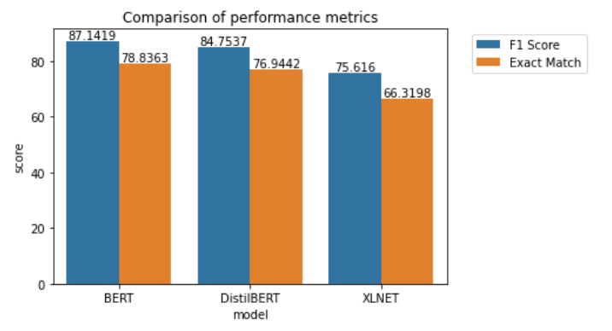
Evaluation Results
Evaluation Metrics
F1 score
Exact Match

Slide 11
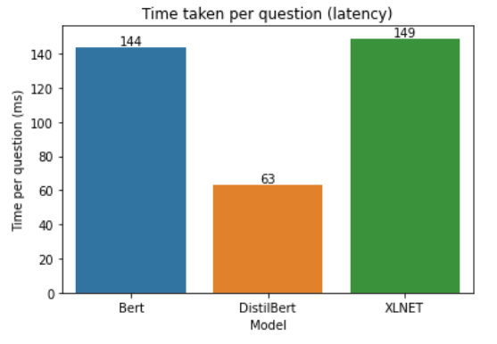
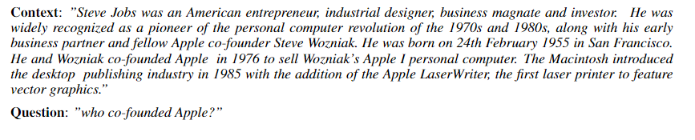
Latency performance
DistilBert is fastest.
More epochs, better performance
Document retriever, to replace context.
Explore other transformer architectures

Slide 12

THANK YOU

Slide 13
APPENDIX

Slide 14
Timeline
Week | Progress
Week 10 | Sampling, cleaning and processing SQuAD
Week 11 | Training language models on SQuAD
Week 12 | Implementing document retriever, document reader
Week 14 | Evaluation of metrics, fine-tuning and cross validation
Week 15 | Final project presentation and report

Slide 15
Responsibilities
Task | Contributors
Literature review | Sakthi, Prem, Srikanth
Data cleaning and processing | Prem, Sakthi
Model Training | Srikanth, Prem
Documents reading and retrieval | Srikanth
Model evaluation and fine tuning | Prem, Sakthi
Project report and presentation | Sakthi, Srikanth, Prem

